Slide 1

Introduction to the Biological Pathway Exchange (BioPAX) Format
MSKCC
Augustin Luna
lunaa@cbio.mskcc.org

Slide 2
BioPAX Scope
To represent biological interactions and pathways
Pathways are collections of interactions that biologists have found useful to group together for organizational, historic, biophysical or other reasons
Types
Metabolic pathways
Signaling pathways
Protein-protein, molecular interactions
Gene regulatory pathways
Encourage a community-wide effort to distribute pathway data in standard format

Slide 3
Sources of Pathway Information
Databases
Computer readable
Literature
Increasingly electronic
Human readable
Biologists
Richest data source
Limited bandwidth access

Slide 4
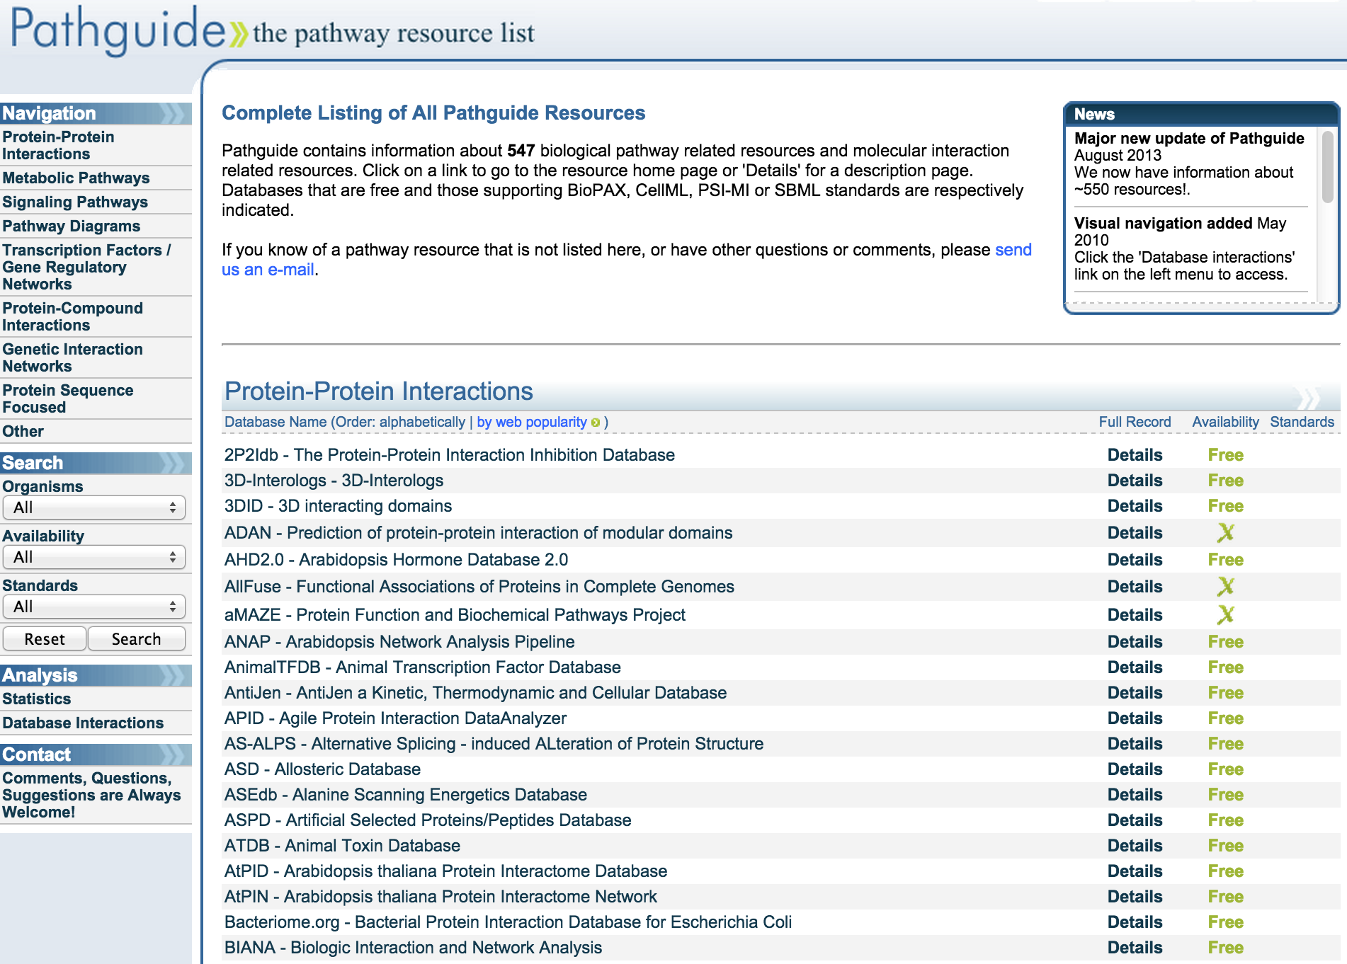
Pathguide: The Pathway Resource List
http://www.pathguide.org/

Slide 5
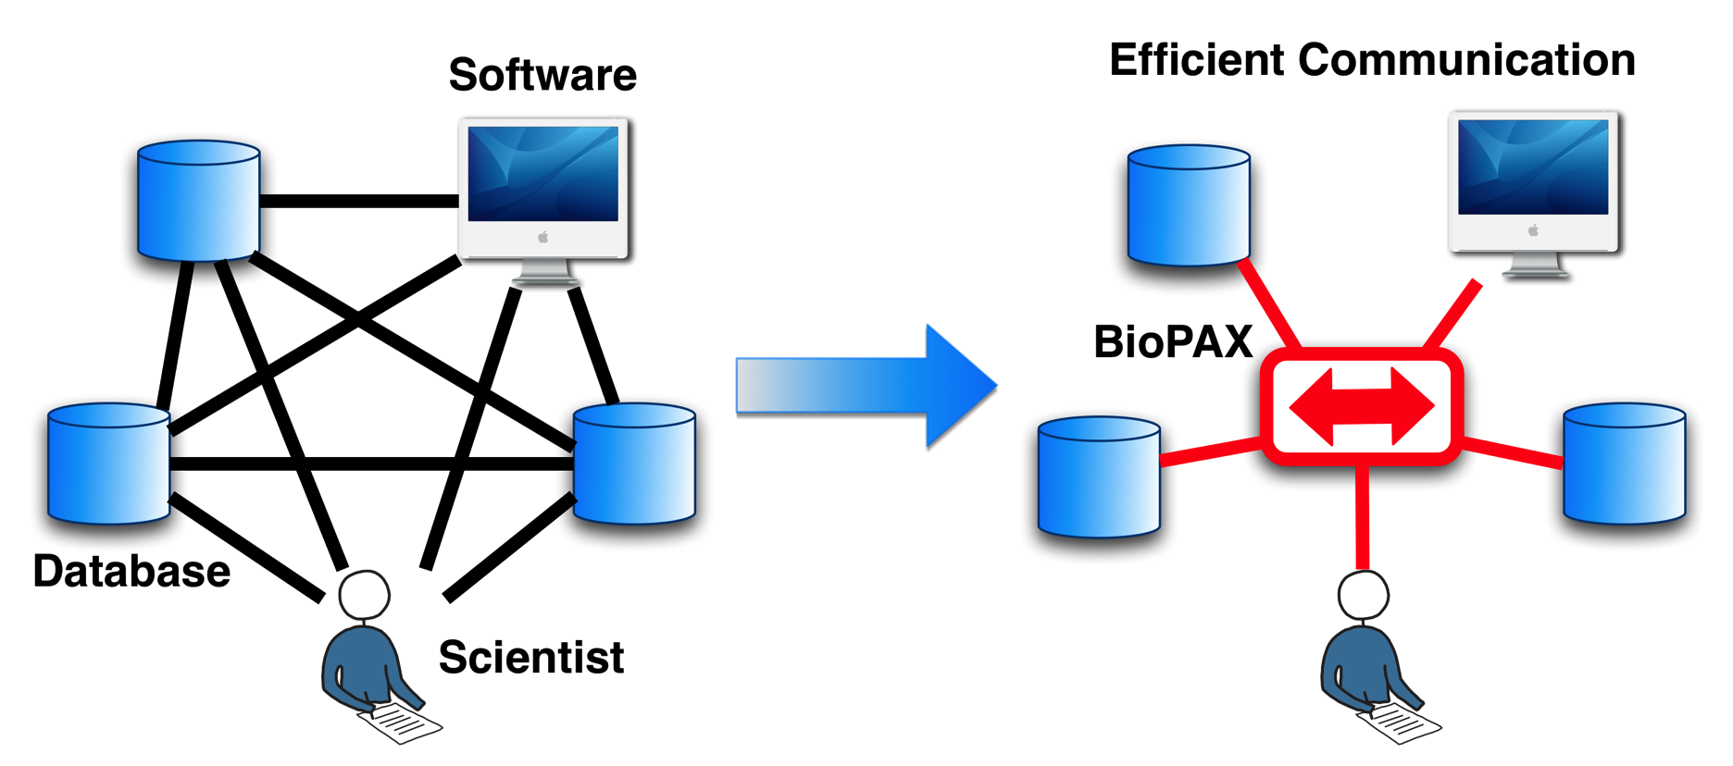
BioPAX Goal: Unification of Pathway Data

Slide 6
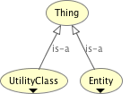
BioPAX Structure: Top-Level
BioPAX is composed of two top-level classes: Entity and UtilityClass
Entities are discrete biological units that participate in pathways
Utility classes annotate Entities without themselves being entities.
Visualized using Protégé: http://protege.stanford.edu/products.php

Slide 7
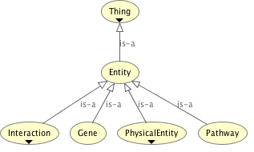
BioPAX Structure: Entity Classes
Pathway: A set of interactions (e.g. glycolysis, MAPK, apoptosis)
Interaction: A basic relationship between a set of entities (e.g. biochemical reactions, catalysis)
Physical Entity: A building block of simple interactions (e.g. small molecule, protein, DNA, RNA)
Gene: An entity that encodes inheritable information (e.g. BRCA1 gene); for use only with genetic interactions (e.g. synthetic lethal interactions)

Slide 8
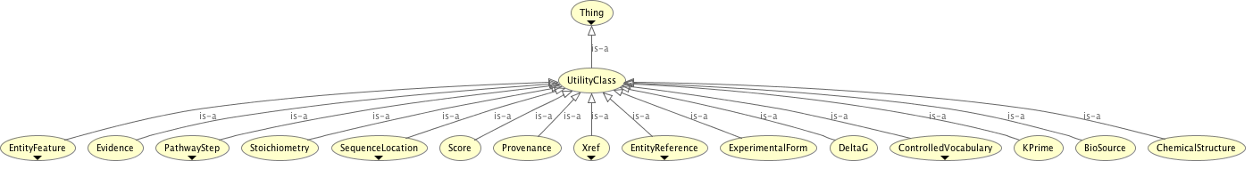
BioPAX Structure: Utility Classes
Select examples
Xref: Cross-references to external databases
EntityReference: A grouping of entities that share common properties (e.g. AKT for AKT1, AKT2, AKT3 or pAKT)
Stoichiometry: Used to define reaction stoichiometry
Biosource: Source of entity (e.g. human)
EntityFeature: An aspect of an Entity that can be modified without changing its basic biological identity (e.g. post-translational modifications)
ControlledVocabulary: Reference to external vocabularies (e.g. Gene Ontology)

Slide 9
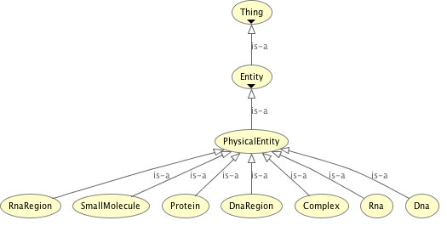
BioPAX Structure: Physical Entity Classes
Comments
Dna refers to DNA generally, while DnaRegion is used to describe a specific region
SmallMolecule can refer to metabolites or drug compounds

Slide 10
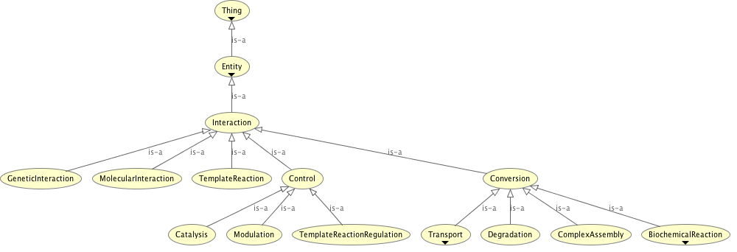
BioPAX Structure: Interaction Classes
Comments
Genetic interactions involve genes (e.g. synthetic lethality)
Molecular interactions: Interactions without a clear mechanism
Template reactions (e.g. DNA replication)
Control interactions (e.g. stimulatory/inhibitory interactions)
Conversion interactions (e.g. metabolic reactions)

Slide 11
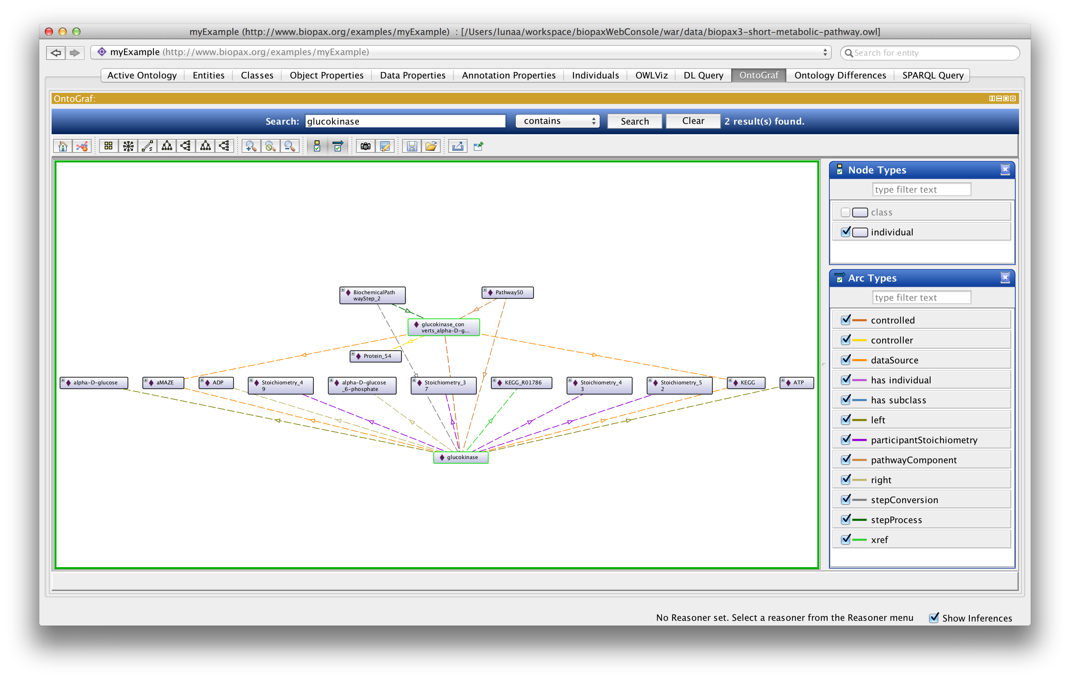
Visualizing OWL Individuals in Protege
Sample File: biopax3-short-metabolic-pathway.owl

Slide 12
Example SmallMolecule as Turtle (Terse RDF Triple Language)
:ADP rdf:type bp:SmallMolecule ;
bp:standardName "ADP"^^xsd:string ;
bp:displayName "Adenosine 5'-diphosphate"^^xsd:string ;
bp:name "adenosine diphosphate"^^xsd:string ;
bp:dataSource :KEGG ;
bp:xref :KEGG_C00008 ;
bp:entityReference :SmallMoleculeReference_10 ;
bp:dataSource :aMAZE ;
bp:cellularLocation :cytoplasm .
:KEGG rdf:type bp:Provenance ;
bp:displayName "KEGG"^^xsd:string ;
bp:standardName "Kyoto Encyclopedia of Genes and Genomes"^^xsd:string .
:KEGG_C00008 rdf:type bp:UnificationXref ;
bp:id "C00008"^^xsd:string ;
bp:comment "PMID: 9847135 "^^xsd:string ;
bp:db "kegg compound"^^xsd:string .
:cytoplasm rdf:type bp:CellularLocationVocabulary ;
bp:comment "This example ..."^^xsd:string ;
bp:term "cytoplasm"^^xsd:string ;
bp:xref :GO_0005737 .
Sample File: biopax3-short-metabolic-pathway.owl

Slide 13
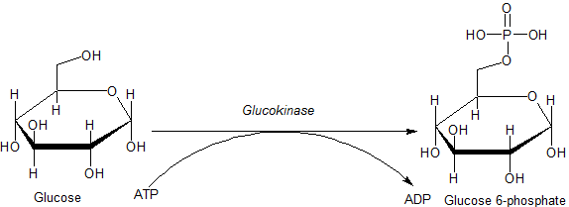
Example BiochemicalReaction
:glucokinase rdf:type bp:BiochemicalReaction ;
bp:eCNumber "2.7.1.1 "^^xsd:string ,
"2.7.1.2 "^^xsd:string ;
bp:name "ATP:D-glucose 6-phosphotransferase "^^xsd:string ;
bp:conversionDirection "REVERSIBLE"^^xsd:string ;
bp:standardName "b-D-glu => b-D-glu-6-p"^^xsd:string ;
bp:displayName "beta-D-glu + ATP => beta-D-glu-6-p + ADP"^^xsd:string ;
bp:name "glucose ATP phosphotransferase "^^xsd:string ;
bp:spontaneous "true"^^xsd:boolean ;
bp:right :ADP ;
bp:left :ATP ;
bp:dataSource :KEGG ;
bp:xref :KEGG_R01786 ;
bp:participantStoichiometry :Stoichiometry_37 ,
:Stoichiometry_43 ,
:Stoichiometry_49 ,
:Stoichiometry_52 ;
bp:dataSource :aMAZE ;
bp:left :alpha-D-glucose ;
bp:right :alpha-D-glucose_6-phosphate .

Slide 14
Connecting BiochemicalReactions to Form Pathways
Example describes the first two interactions in glycolysis: the conversion of glucose to glucose-6-phosphate and then glucose-6-phosphate to fructose-6-phosphate
A pathwayComponent is a set of interactions defining a step in the pathway (e.g. catalysis and the catalyzed conversion)
The pathwayOrder is an object property for the Pathway that has a PathwayStep as its range (value). Within a PathwayStep, the interactions taking place are defined and also the next steps (i.e. property nextStep) in the pathway.
:Pathway50 rdf:type bp:Pathway ;
bp:comment ""^^xsd:string ;
bp:availability "All data within the pathway has the same ..."^^xsd:string ;
bp:name "Embden-Meyerhof pathway"^^xsd:string ;
bp:displayName "Glycolysis Pathway"^^xsd:string ;
bp:comment "This example is meant to ..."^^xsd:string ;
bp:name "glucose degradation"^^xsd:string ;
bp:standardName "glycolysis"^^xsd:string ;
bp:availability "see http://www.amaze.ulb.ac.be/"^^xsd:string ;
bp:pathwayOrder :BiochemicalPathwayStep_2 ,
:BiochemicalPathwayStep_3 ;
bp:organism :Escherichia_coli ;
bp:dataSource :KEGG ;
bp:xref :PublicationXref49 ;
bp:dataSource :aMAZE ;
bp:pathwayComponent :glucokinase ,
:glucokinase_converts_alpha-D-glu_to_alpha-D-glu-6-p ,
:phosphoglucoisomerase ,
:phosphoglucose_isomerase_converts_alpha-D-gluc-6-p_to_bet... .

Slide 15
Ordering Pathway Interactions
The pathwayOrder is an object property for the Pathway that has pathwaySteps as its range (value). Within a PathwayStep, the interactions taking place are defined and also the next steps (i.e. property nextStep) in the pathway.
BiochemicalPathwayStep_2 defines property "nextStep" that specifies BiochemicalPathwayStep_3 as the next step in the pathway (i.e. the step involving conversion to fructose-6-phosphate)
stepConversion: glucokinase (the central step)
stepProcess: glucokinase_converts_alpha-D-glu_to_alpha-D-glu-6-p (a catalysis by Protein_54 (i.e. GLK) that controls stepConversion "glucokinase”)
Defining the ordering (e.g. temporal) of pathways using PathwaySteps
:BiochemicalPathwayStep_2 rdf:type bp:BiochemicalPathwayStep ;
bp:stepDirection "LEFT-TO-RIGHT"^^xsd:string ;
bp:nextStep :BiochemicalPathwayStep_3 ;
bp:stepConversion :glucokinase ;
bp:stepProcess :glucokinase_converts_alpha-D-glu_to_alpha-D-glu-6-p .

Slide 16
Grouping Entity States with EntityReferences
EntityReference A grouping of entities that share common properties (e.g. AKT for AKT1, AKT2, AKT3 or pAKT)
:Protein_54 rdf:type bp:Protein ;
bp:standardName "GLK"^^xsd:string ;
bp:name "GLK_ECOLI"^^xsd:string ;
bp:displayName "glucokinase"^^xsd:string ;
bp:entityReference :ProteinReference_15 ;
bp:dataSource :SwissProtTrEMBL ;
bp:xref :SwissProtTrEMBL_P46880 ;
bp:dataSource :aMAZE ;
bp:cellularLocation :cytoplasm .
:ProteinReference_15 rdf:type bp:ProteinReference ;
bp:standardName "GLK"^^xsd:string ;
bp:sequence "MTKYA..."^^xsd:string ;
bp:displayName "glucokinase"^^xsd:string ;
bp:name "glucose kinase"^^xsd:string ;
bp:organism :Escherichia_coli ;
bp:xref :SwissProtTrEMBL_P46880 .

Slide 17
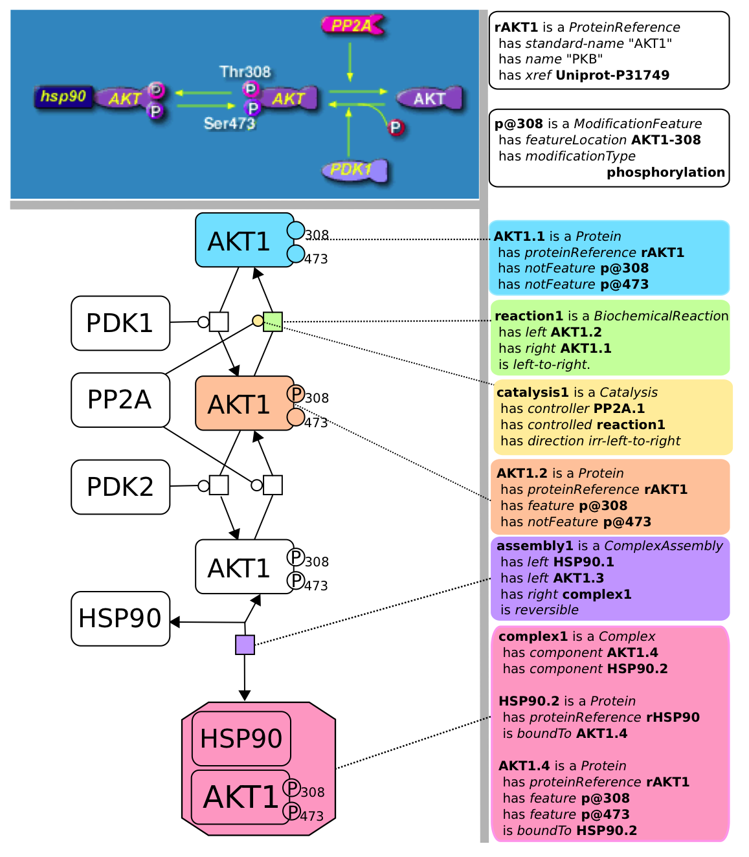
BioPAX Visual Representation Using the Systems Biology Graphical Notation (SBGN)

Slide 18
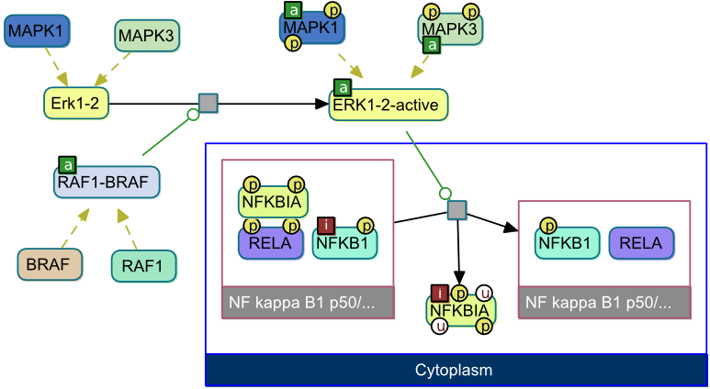
ChiBE: Chisio BioPAX Editor
Babur, Ö., et al. (2014). BMC Genomics.
https://code.google.com/p/chibe/

Slide 19
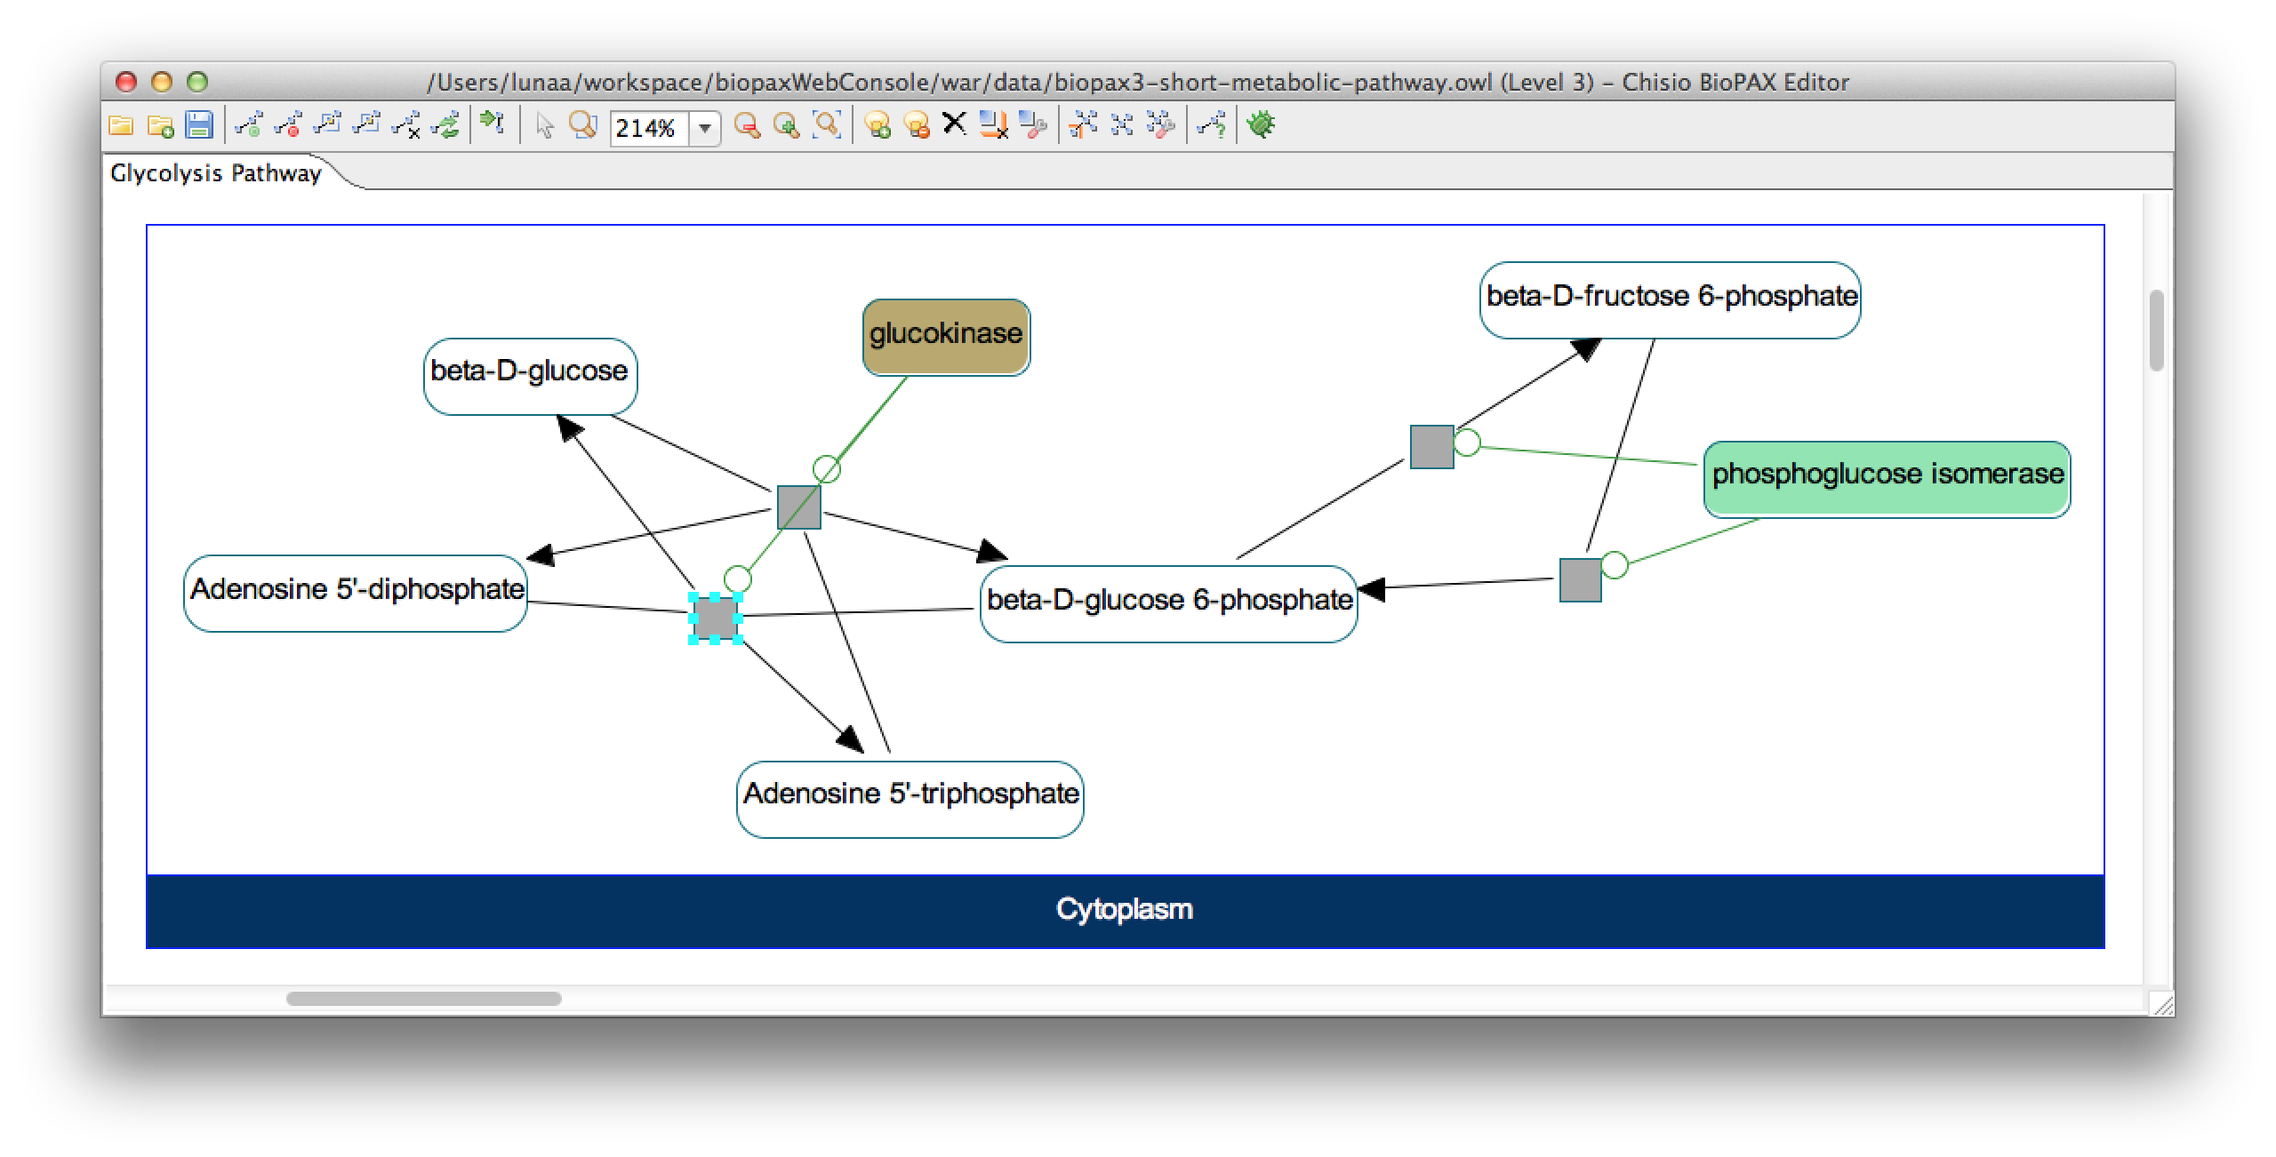
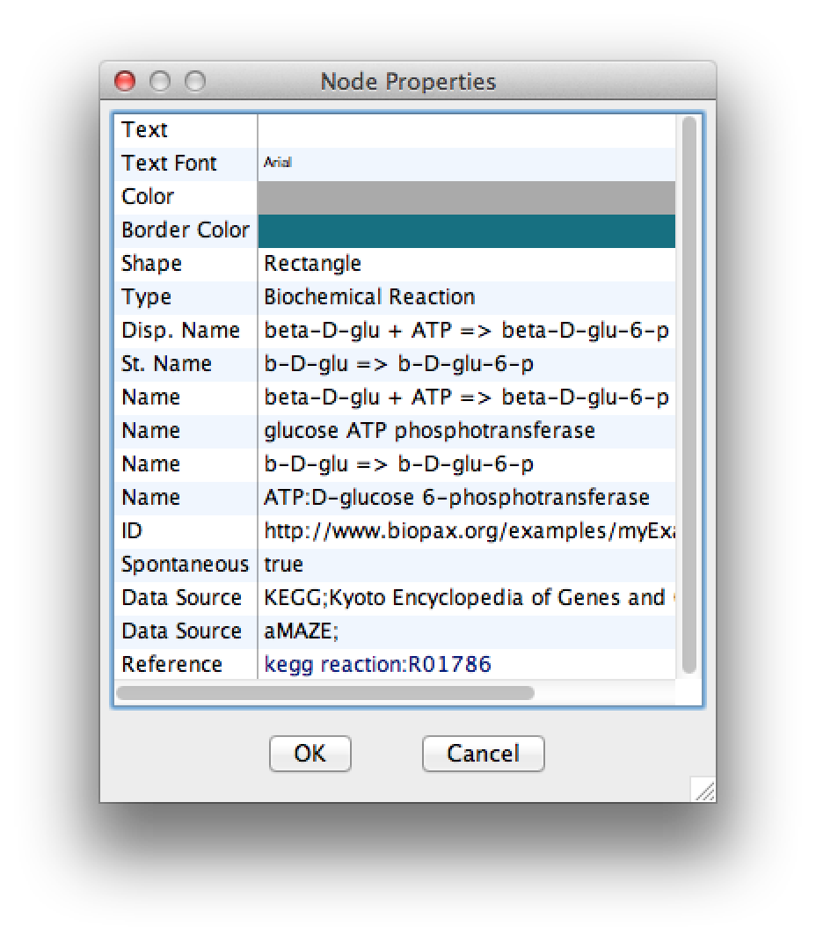
Visualizing and Exploring BioPAX in ChiBE
Sample File: biopax3-short-metabolic-pathway.owl

Slide 20
Simplified Representation of BioPAX Interactions
Simple Interaction Format (SIF)
An edgelist with interaction type
Expected representation for many network analyses
Extracted using graph queries that detect biologically interesting interaction patterns in Pathway Commons data
Complexes, metabolic, modification, control interactions
Generates binary interactions and integrates them across databases

Slide 21
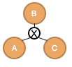
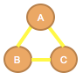
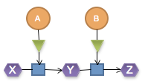
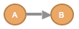
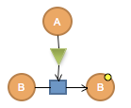
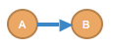
Examples BioPAX to SIF Conversions
BioPAX
SIF
in-complex-with
catalysis­precedes
controls­state-change-of
14 Interaction Types Total
Babur et al (in preparation)

Slide 22
Getting BioPAX Data
BioPAX is available from many providers and data can be used with Paxtools (a BioPAX Java API)
Indicated on http://pathguide.org/
Paxtools: http://sourceforge.net/projects/biopax/
The majority of BioPAX-formatted data is available through Pathway Commons

Slide 23
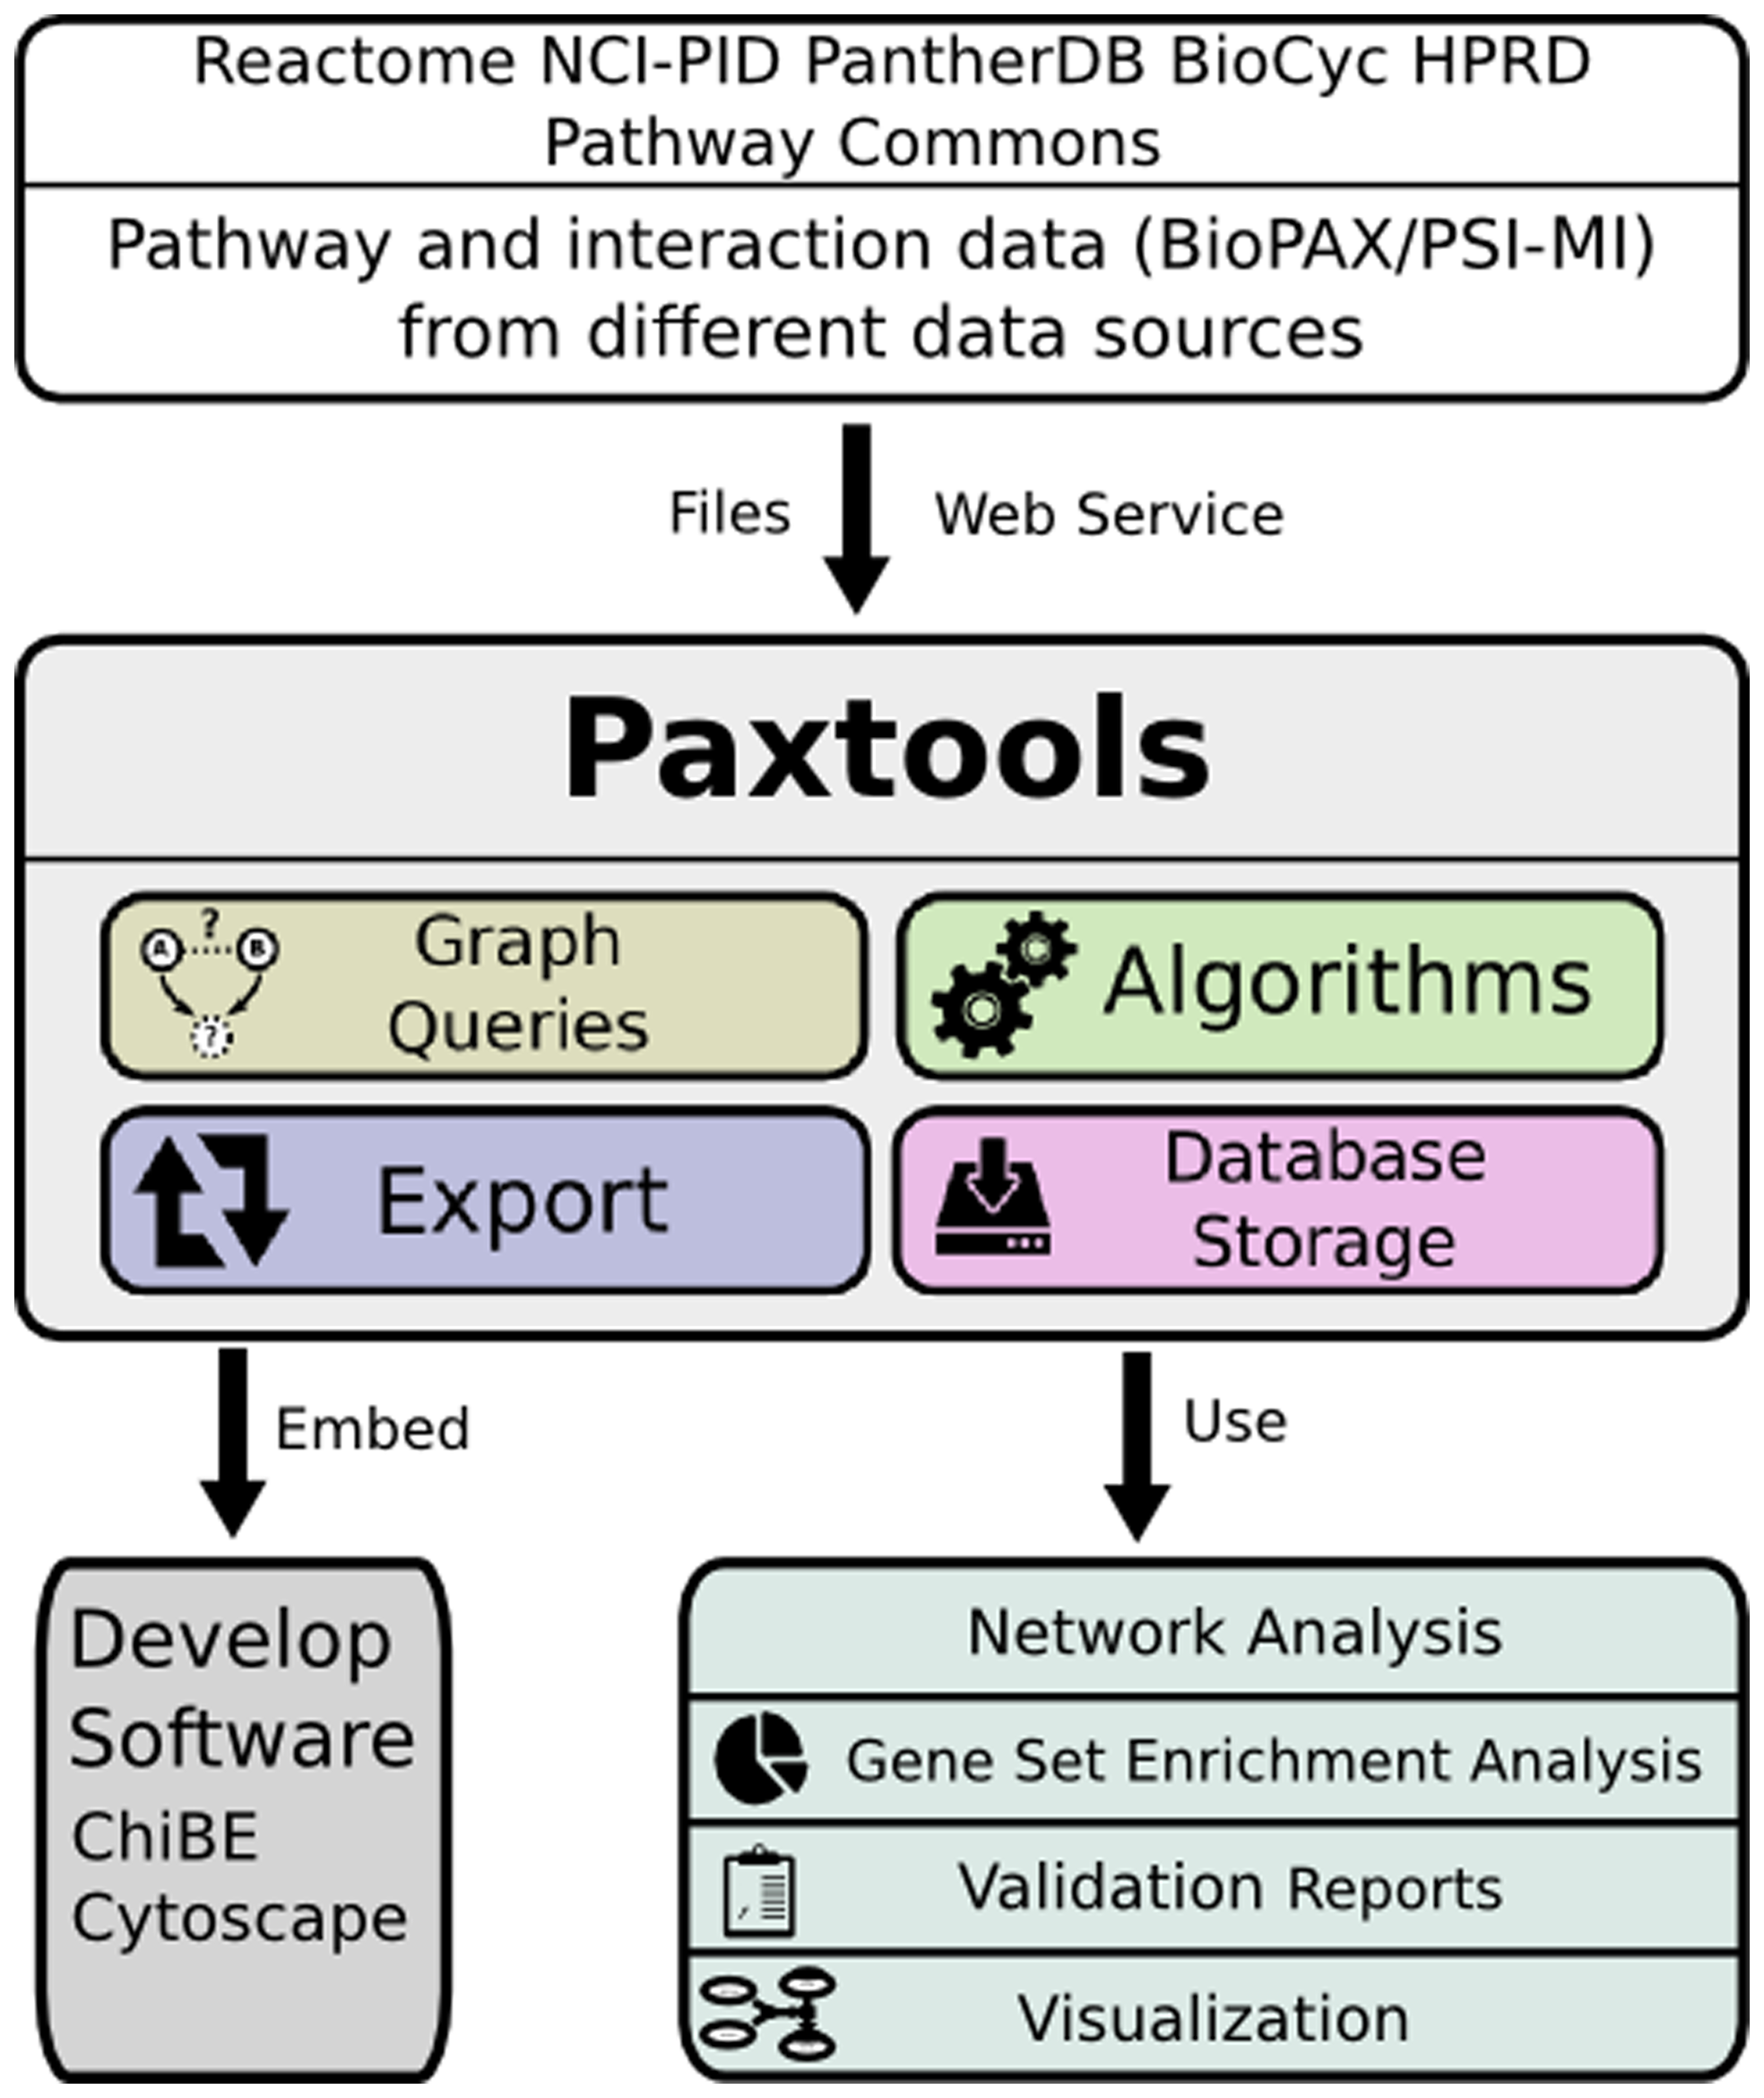
Paxtools: Biological Pathway Exchange (BioPAX) Format Java API
Demir et al (2013)
Notes:
BioPAX, now in Level 3, has been stable for a while

Slide 24
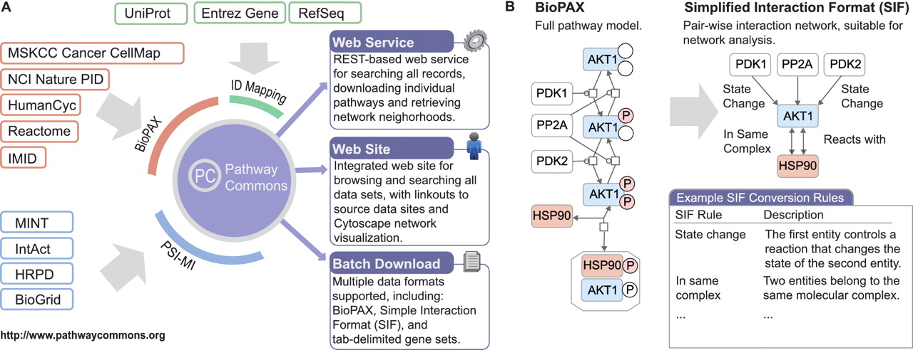
Pathway Commons Database
Cerami et al (2011)

Slide 25
Interactions and Databases in Pathway Commons (as of July 2015)
Pathway Commons includes a growing set of databases across a spectrum of databases: signaling, drug/target, metabolic, regulatory, etc.
Reactome | 11924
NCI PID | 16017
PhosphoSitePlus | 13642
HumanCyc | 7024
HPRD | 40618
PantherDB | 5282
DIP | 7102
BioGRID | 244843
InAct | 98347
BIND | 35566
TRANSFAC | 261624
mirTarBase | 51214
DrugBank | 19159
Recon X | 10910
CTD | 313174
KEGG | 4472
Total | 1140918

Slide 26
Acknowledgements: Main Team
MSKCC
Arman Aksoy
Ozgun Babur
Emek Demir
Onur Sumer
Chris Sander
Bilkent University
Ugur Dogrusoz
University of Toronto
Gary Bader
Igor Rodchenkov
Notes:
Add Ed and Rileen

Slide 27
Acknowledgements (2)
Current Participants
SRI Bioinformatics Research Group: P. Karp, S. Paley, J. Pick
Université Libre de Bruxelles: C. Lemer
CBRC Japan: K. Fukuda
Dana Farber Cancer Institute: J. Zucker
Millennium: J. Rees, A. Ruttenberg
Cold Spring Harbor/EBI: G. Wu, M. Gillespie, P. D'Eustachio, I. Vastrik, L. Stein
BioPathways Consortium: J. Luciano, E. Neumann, A. Regev, V. Schachter
Argonne National Laboratory: N. Maltsev, E. Marland, M.Syed
Harvard: F. Gibbons
AstraZeneca: E. Pichler
BIOBASE: E. Wingender, F. Schacherer
NCI: M. Aladjem, C. Schaefer
Università di Milano Bicocca, Pasteur, Rennes: A. Splendiani
Vassar College: K. Dahlquist
Columbia: A. Rzhetsky
Collaborating Organizations
Proteomics Standards Initiative (PSI)
Systems Biology Markup Language (SBML)
CellML
Chemical Markup Language (CML)
Additional Projects
Gene Ontology
CHEBI
SwissProt
UniChem
Protégé, U.Manchester, Stanford
Notes:
Many other people have contributed in discussions in person and on the mailing list and we would like to thank them as well.

